Slide 1
Distributed Computing(1)
Introduction
Lecturer: 尚振宏
Email: shangzhenhong@126.com

Slide 2
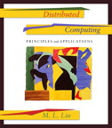


Bibliography
M.L.Liu. Distributed Computing: Principles and Applications. 清华大学出版社. 2004年4月
Java materials：http://java.sun.com

Slide 3
Definitions
Distributed System: a collection of independent computers, interconnected via a network, that are capable of collaborating on a task.
  loosely coupled: computers do not share memory or program execution space;
  tightly coupled: share data using common memory space.
Distributed Computing: Computing performed in a distributed system, such as network service or network application.
  network service: a service provided by a special kind of program known as a server on a network.
  network application: is an application that runs on networked computers for end users.

Slide 4
Different Forms of Computing
Monolithic Computing
  Computing in a single computer;
  Single computer shared by users by timesharing;
Distributed Computing
  Computing performed among multiple network-connected computers;
  example: WWW;
parallel Computing
  Typically use more than one CPU simultaneously to execute a single program.
Cooperative Computing
  another branch of distributed Computing, which solves a large problem by giving small parts of the problem to many computers to solve and then combining the solutions for the parts into a solution for the problem.

Slide 5
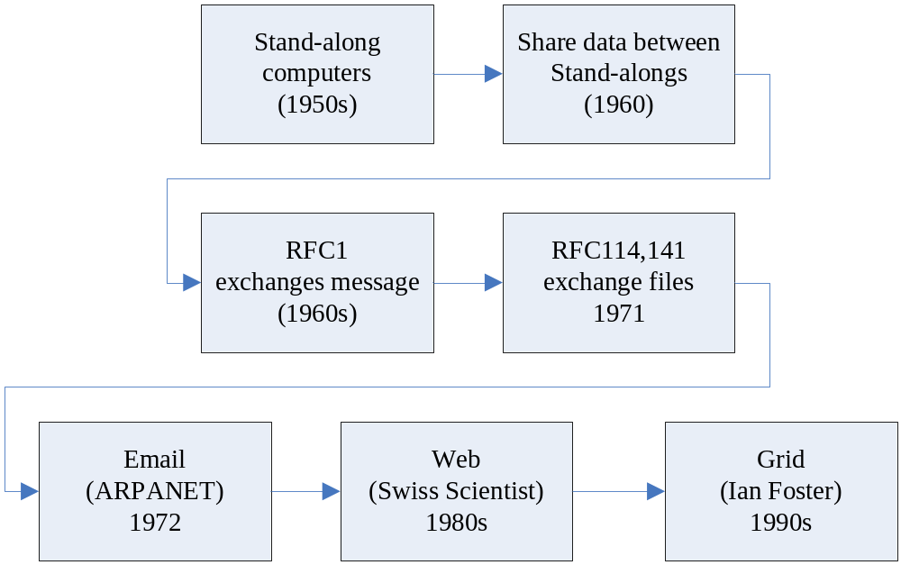
History of Distributed Computing

Slide 6
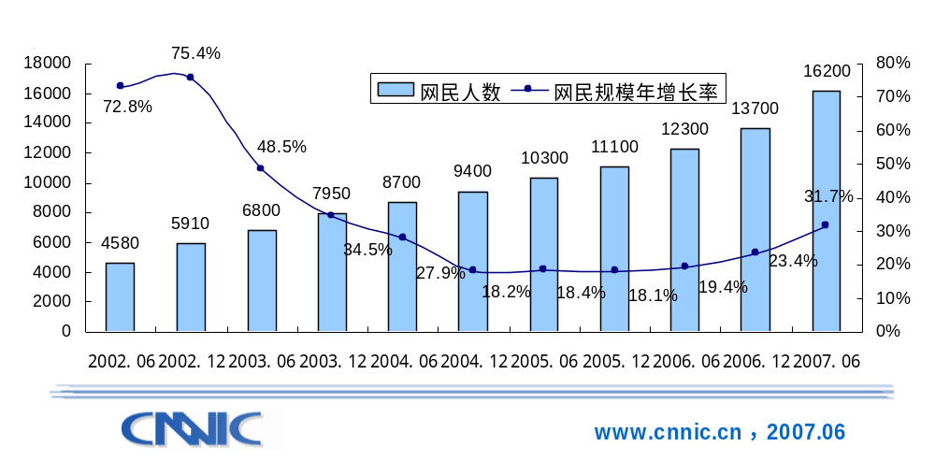
Internet in China (1)
Number of users

Slide 7
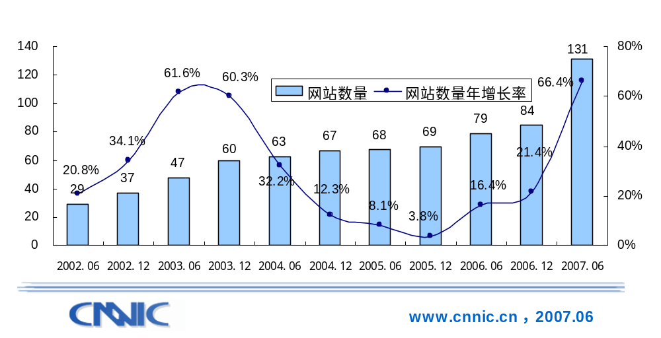
Internet in China (2)
Number of web sites

Slide 8
Examples of Distributed Computing（1）
SETI（The Search for Extraterrestrial Intelligence）
  http://www.equn.com/seticn/
  位于加州伯克立大学的SETI@home项目组把阿雷西波(Arecibo)射电望远镜采集到的海量信息分成一个个小数据包，发送到互联网上。每台安装了SETI@home软件的电脑都可以自动下载这些数据，以运行屏幕保护或者后台程序的方式参与数据分析。目前共有226国家和地区、超过500万的个人和团体参加了这项浩大工程使用的CPU时间超过224万年，如此多电脑联合起来，已经超过了世界上任何一台超级计算机的处理能力。

Slide 9
Country Statistics of SETI
Country | Users | Results_x000b_received | Total CPU time | Population | Participants_x000b_per capita
1) United States | 2173136 | 857721999 | 1171014.370 years | 273131194 | 0.007956
2) Germany | 494542 | 205918292 | 203927.448 years | 82561399 | 0.005990
3) United Kingdom | 396764 | 136211002 | 150014.175 years | 59355419 | 0.006685
4) Canada | 270180 | 98262891 | 132502.604 years | 30957019 | 0.008728
5) Japan | 173071 | 71399504 | 81407.308 years | 126314453 | 0.001370
19) China | 63344 | 13445908 | 10292.550 years | 1250463856 | 0.000051

Slide 10
Examples of Distributed Computing（2）
Folding@home
  http://www.equn.com/folding/
  Folding@home是一个研究蛋白质折叠、误折、聚合及由此引起的相关疾病的分布式计算工程。它使用联网式的计算方式和大量的分布式计算能力来模拟蛋白质折叠的过程，并指引我们近期对由折叠引起的疾病的一系列研究。中国很少有人参加这个项目。

Slide 11
Examples of Distributed Computing（3）
FightAIDS@home
  http://www.equn.com/faids/
  使用您的计算机研究艾滋病的生理致病原理并寻找对抗 HIV 病毒的药物活性分子。

Slide 12
Examples of Distributed Computing（4）
ClimtePrediction
  http://www.equn.com/cpdn/
  Climateprediction.net工程是把最新的气候预测模型通过家庭、学校、办公室的计算机来进行计算。这些计算完成的结果将会组成世界最大的气象预测模型。

Slide 13
The Advantages and Weakness of Distributed Computing
Advantages
  Resource Sharing
  Scalability
  Fault tolerance
Weakness
  Multiple points of failure
  Security concerns

Slide 14
Knowledge to be taught in this course (1)
Base Knowledge for Distributed Computing
  Basics of Operating Systems
    Computer Programs and Processes
    Concurrent Programming
      Concurrent process executed on multiple computers
      Concurrent process executed on a single computer
      Concurrent process executed in a process: Child Process, thread
  Interprocess Communications
    Event Synchronization
    Connection-Oriented VS. connectionless IPC
  Distributed Computing Paradigms
    Client-Server Paradigm
    The Peer-To-Peer Paradigm
The Socket API
Client-Server Paradigm
  Event Synchronization
  Software Engineering for a Network Service.

Slide 15
Knowledge to be taught in this course (2)
Group Communication
  Multicast API
  Connectionless multicast vs. Connect-Oriented multicast
  Reliable Multicasting vs. Unreliable Multicasting
Distributed Object
  Remote Method Invocation
  The Java RMI Architecture
  the API for Java RMI
CORBA ( Common Object Request Broker Architecture)
  Object Servers and Object Clients
  CORBA Object Reference
  CORBA Naming Service
Internet Application
  XML-The Extensible Markup Language
  Servlet
  Web Services-The Simple Object Access Protocol (SOAP)

